Slide 1
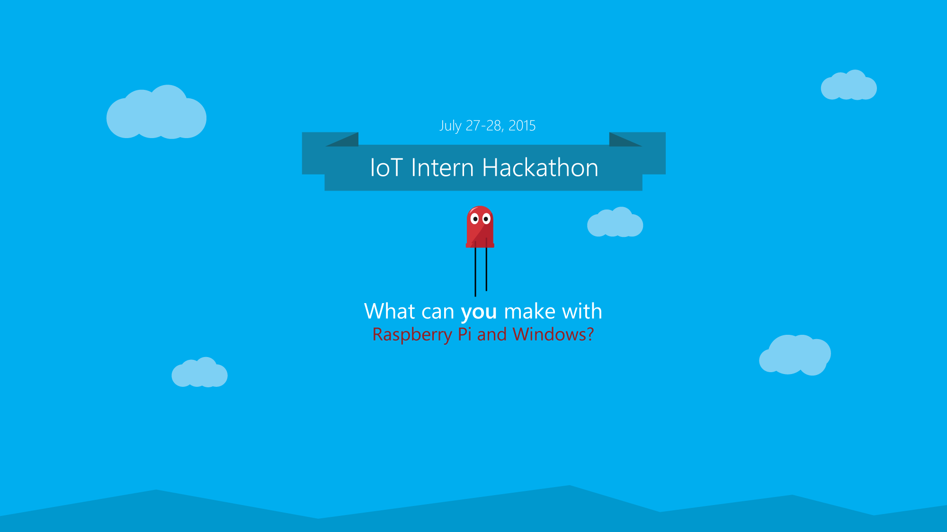
Windows 10 IoT Core

Slide 2
Schedule
Day 1
10 am – 12 pm | Presentations
12 pm – 1 pm | Lunch
1 pm – 5 pm | Building
Day 2
10 pm | Start building
4 pm | Submissions due
4:30 pm | Voting ends/ Prizes

Slide 3
Rules
No taking equipment out of the tent!
You can bring any equipment
Must use the LED
Must use the speakers

Slide 4
Voting
The IOT team will vote on their favorite project
You need to have a hackster.io project

Slide 5
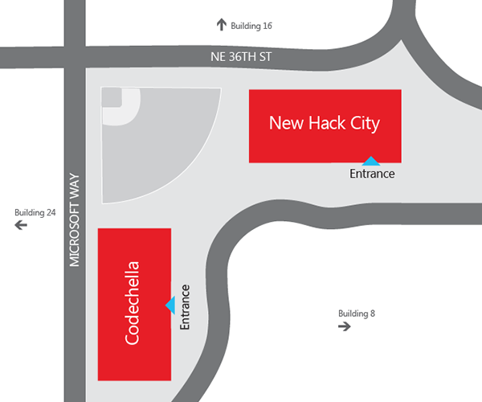
Where are we hacking?
New Hack City

Slide 6
Remember
This hackathon isn’t about technical skill and writing good code
It’s about fun creative projects!

